Slide 1
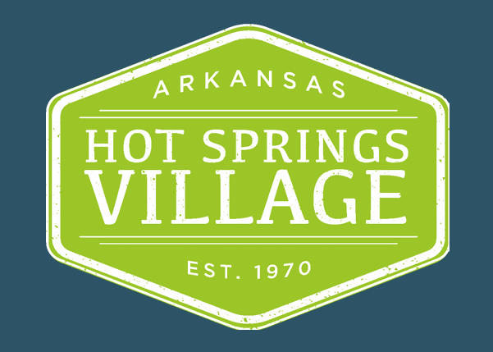
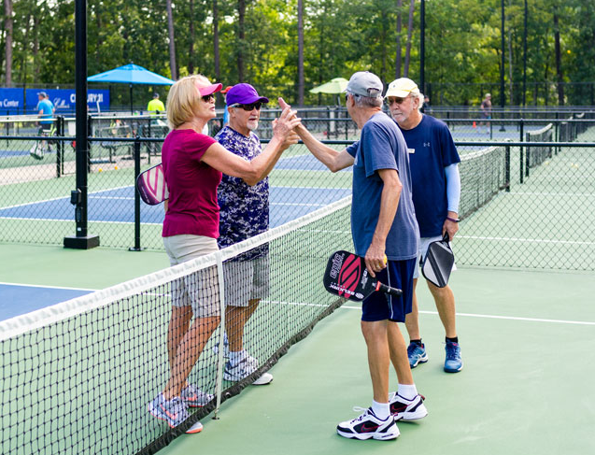
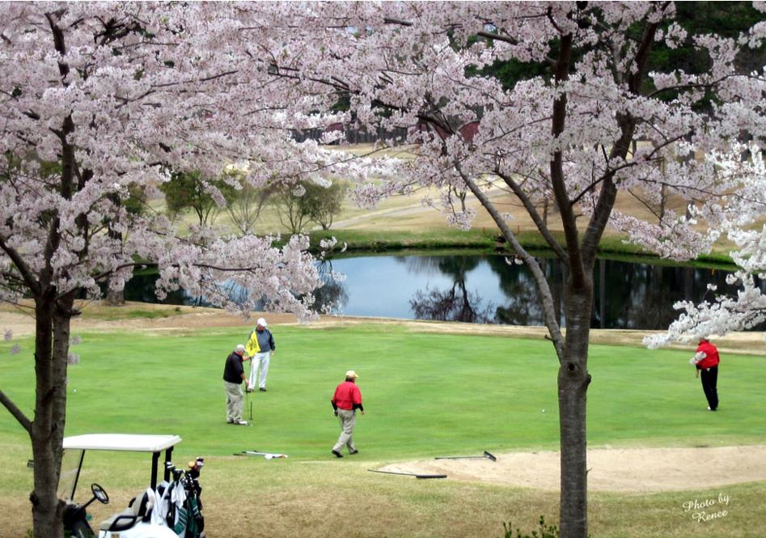
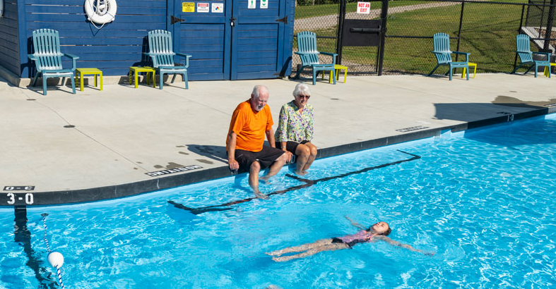
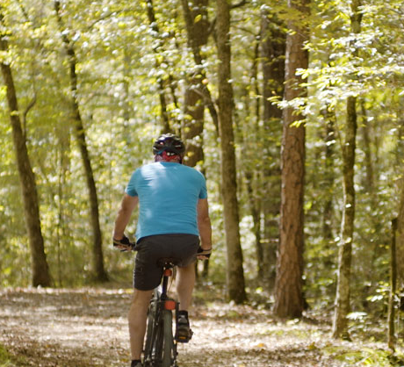
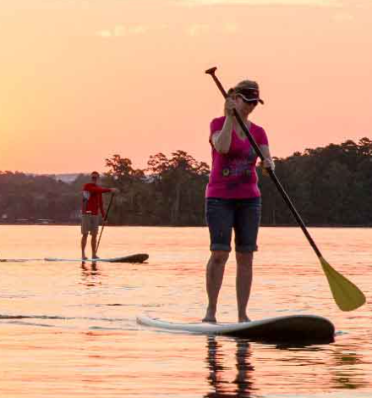
Digital Lead Generation Campaign
Hot Springs Village:
2021 Prospective New Residents Campaign

Slide 2
Goals and Strategy
Campaign objectives
Target audience and overall strategy
Marketing Goals
Primary: Drive existing home sales, lot sales and building permits with the goal of 125 new building permits in 2021.
Secondary: Grow revenue from current residents by marketing increased amenities usage (golf, fitness club, racquet sports, entertainment, dining). Grow golf tourism package revenue from non-residents.
Target Audience
Empty nesters, retirees and those nearing and planning for retirement. They have moderate to high household wealth and seek an active, affordable lifestyle.
Only a small percentage of retiring people want to move from their present home; of those who want to move, most do not want to move far (the grandparent effect).
Our challenge is to connect with those who would consider moving to an isolated gated community in the middle of Arkansas from one or more states away.
Strategies
Time and target digital media to reach a self-selecting audience: People searching for lifestyle and retirement communities.
Monitor tactics, markets and search keywords that drive website traffic and leads. Adjust media buys frequently.
Maintain a robust, cooperative Real Estate Partners Program to support and drive leads to independent selling agents. Leverage their additional marketing investments.
Build strong relationships with Arkansas Department of Tourism to promote HSV and obtain free, high-quality assets and media extensions: video, photo, websites, social media.

Slide 3
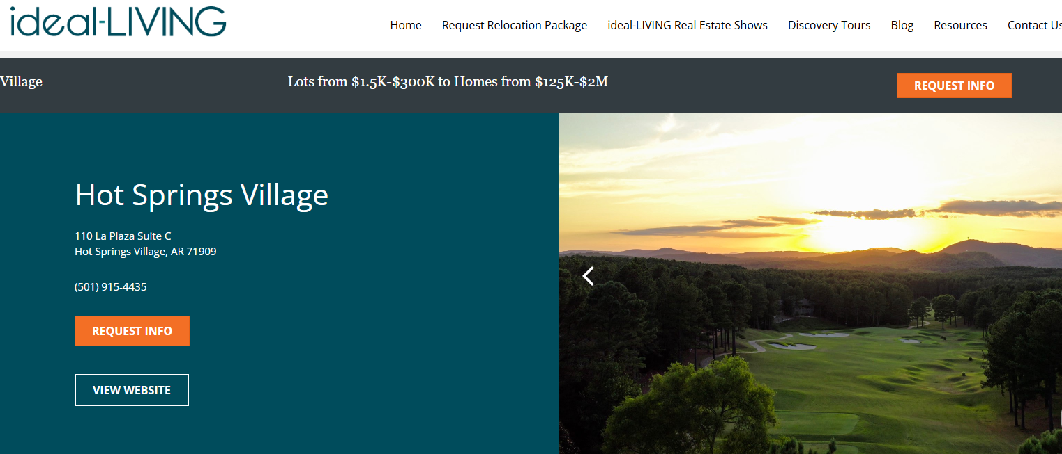
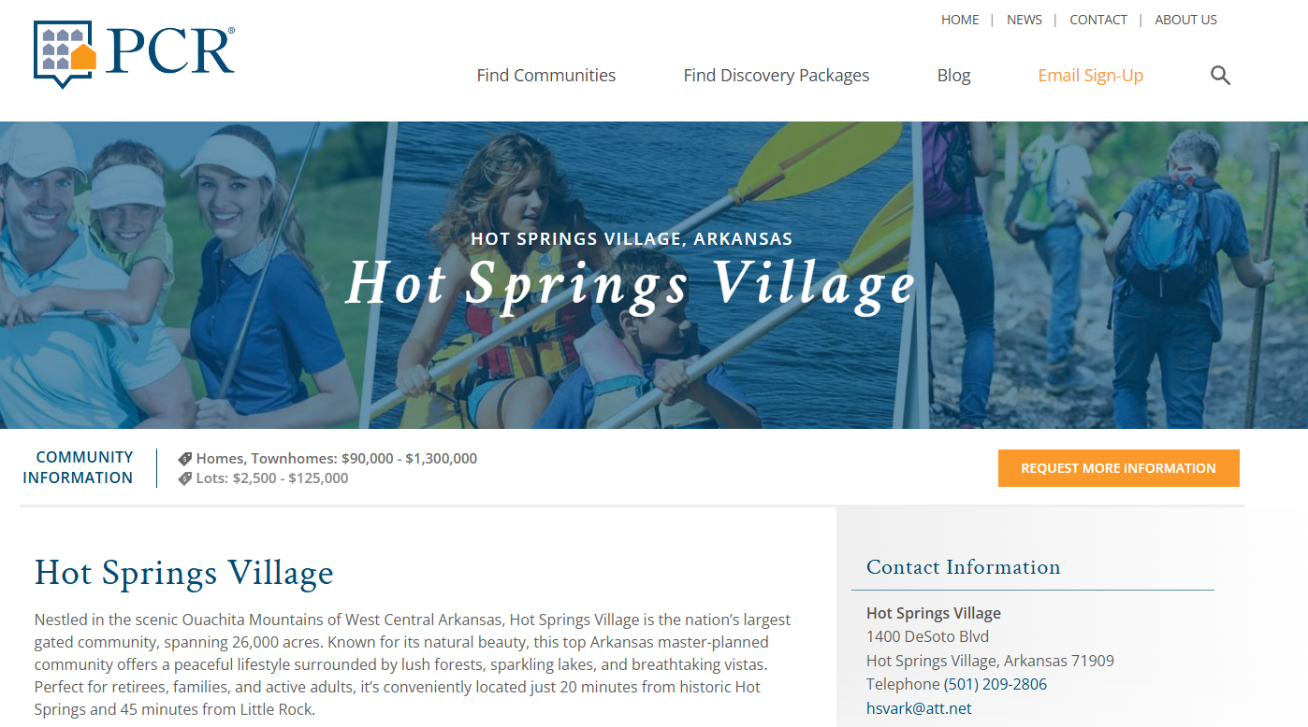
Deliverables
Key campaign elements (e.g., emails, ads, landing pages, blog posts).
Tools or platforms used.
Paid Marketing Tactics
Prospective Residents Lead Generation
Paid Advertising
  Search (national reach)
  Display (target-market reach)
  Online Video (target-market reach)
  Facebook (target-market, demographic reach)
Cost-effective listings on national lifestyle community websites:
  ideal-LIVING
  Privatecommunities.com (PCR)
Golf Packages
Markets within 6-hour drive or less (Dallas, Memphis, Tulsa)
Seasonal window (Spring and Fall)
Facebook and Paid Search
Website and SEO
Continuous improvement to website (totally revised June 2020)
Lesson Learned:
  Today I know more about SEO than I did in 2021.
  I could have driven more website traffic with blogs, backlinks and other SEO tools.

Slide 4
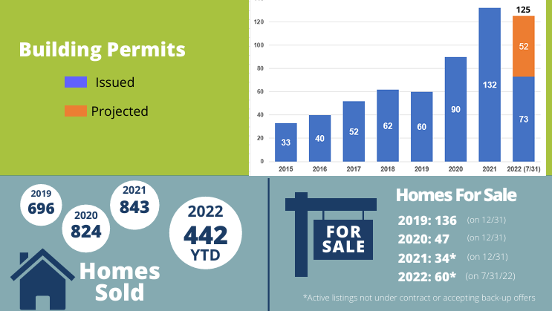
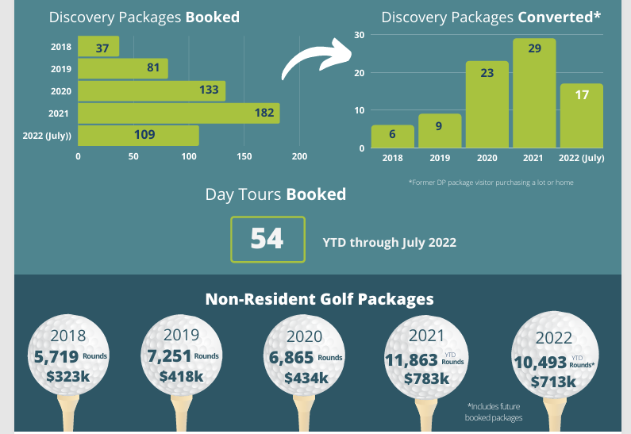
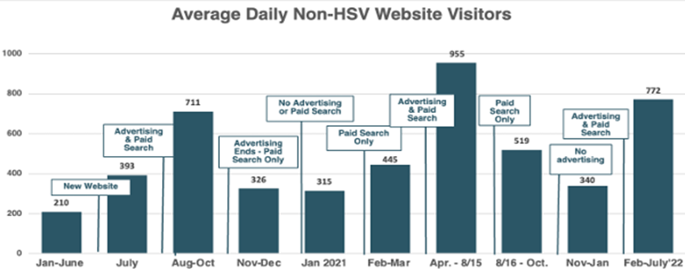
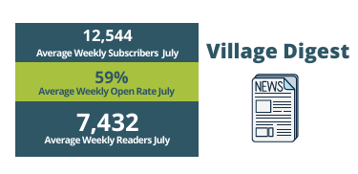
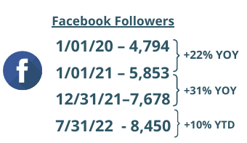
Results
  Measurable outcomes (e.g., leads generated, engagement metrics, ROI).
  Adjustments made during the campaign to optimize performance.
Building Permits
2021: 132 (goal 125)
Jan-July 2022: 73
Leads Generated
2021: 1,182
Jan-July 2022: 821
Non-Resident Golf
Packages Revenue
2021: $783k
Jan-July 2022: $713k
22% Readership Increase/12 months

